Slide 1

One World Centre
educating for justice and sustainability
Education for Global Citizenship: Teaching about countries and cultures

Slide 2





What is the One World Centre?
The OWC is a non-government, not-for-profit organisation which provides transformative education, with the aim of encouraging and supporting an active and engaged citizenship, and a just and sustainable future for all.
We offer professional development workshops on a range of global and development issues at the centre, in schools and at universities for teachers and pre-service teachers.
The OWC library provides a wide range of global education teaching and learning resources suitable for teachers and students.
Check out the OWC at:
www.oneworldcentre.org.au
Notes:
2
2

Slide 3
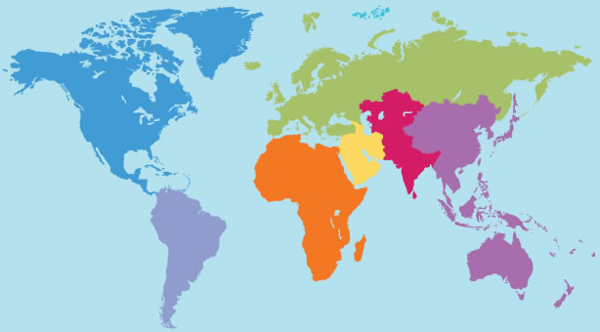
State of the World

Slide 4
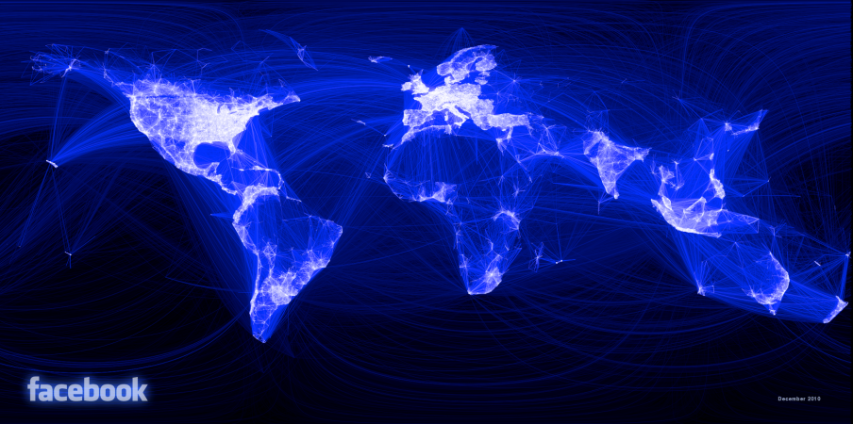
“…the lines didn't represent coasts or rivers or political borders, but real human relationships… It's not just a pretty picture, it's a reaffirmation of the impact we have in connecting people, even across oceans and borders...”
Notes:
http://www.facebook.com/notes/facebook-engineering/visualizing-friendships/469716398919

Slide 5
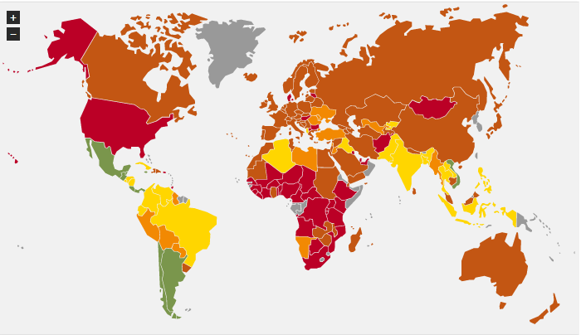
www.happyplanetindex.org

Slide 6
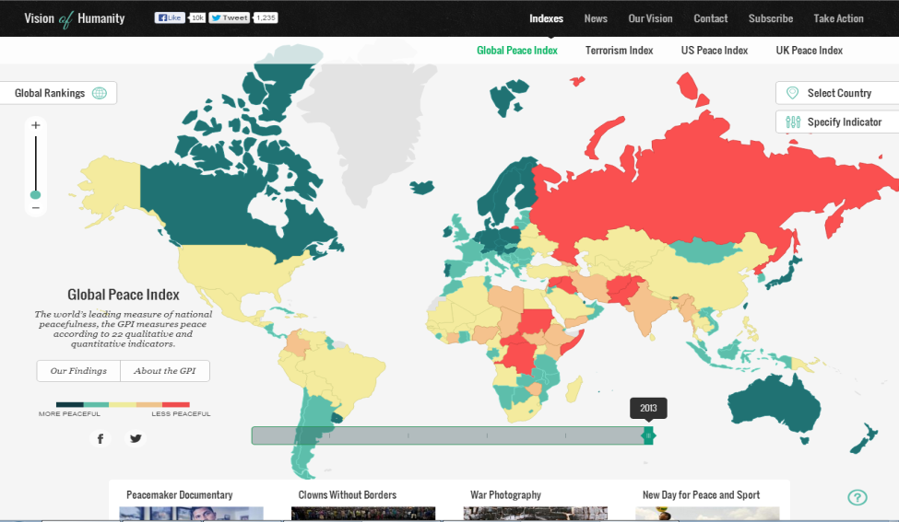

Slide 7
What’s Global Education?
“Enabling young people to participate in a better shared future for all is at the heart of global education.
Global education promotes open-mindedness leading to new thinking about the world and a predisposition to take action for change. Students learn to take responsibility for their actions, respect and value diversity, and see themselves as global citizens who can contribute to a more peaceful, just and sustainable world”
Global Perspectives: A framework for global education in Australian Schools Commonwealth of Australia, 2008

Slide 8
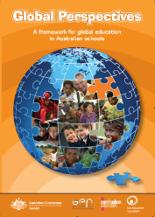
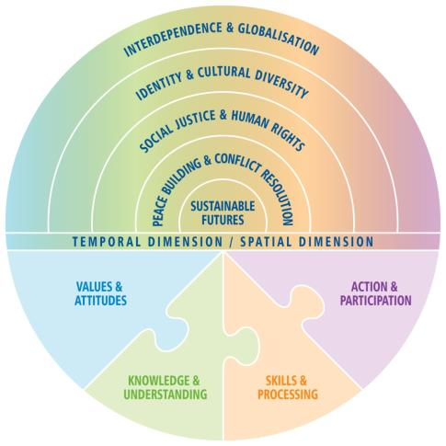
‘Global Perspectives’ is the framework for global education in Australia. It outlines the values, knowledge, skills, and opportunities for action that are needed to prepare for global citizenship within five interconnected learning emphases.
Notes:
8
8
The ‘Developing Global Citizens’ CD is a good introduction to GE.
Focus on: The Intro, Go Global Car Game, Eco Housing and Global Perspectives sections as they are most relevant to secondary schools.
You may also wish to read the information in the Teacher Background section, and review some of the sample units of work most relevant to your learning area. The insert in the CD has a summary table of these sample units.

Slide 9
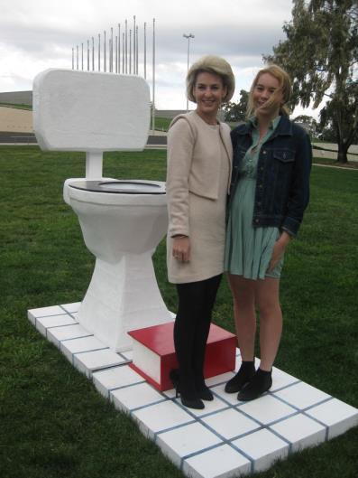
Actions for Change
LEARN
TALK
BUY
DONATE
SHOUT
VOLUNTEER
LIVE
http://www.globaleducation.edu.au/teaching-and-learning/school-case-studies.html

Slide 10

Goal 2: All young Australians become successful learners, confident and creative individuals, and active and informed citizens
2008 Melbourne Declaration on Educational Goals for Young Australians.
Notes:
10

Slide 11

  Active and informed citizens:
        are committed to national values of democracy, equity and justice, and participate in Australia’s civic life
are able to relate to and communicate across cultures
work for the common good, in particular sustaining and improving natural and social environments
are responsible global and local citizens.
act with moral and ethical integrity

Slide 12
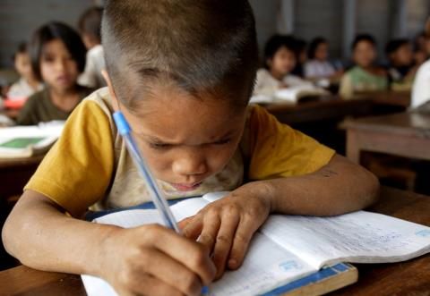
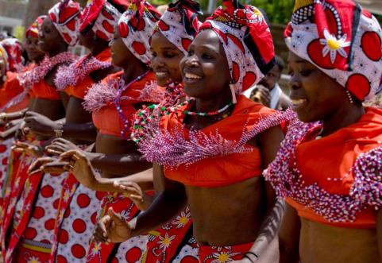

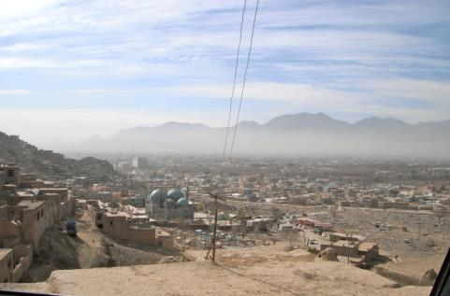
Global Fact Match
Photo credits: Australian Aid and One World Centre

Slide 13
RUMOUR CLINIC
From Theme Work: Approaches for Teaching with a Global Perspective. Development Education Centre
Notes:
Questions - What were your impressions of the picture?

Slide 14
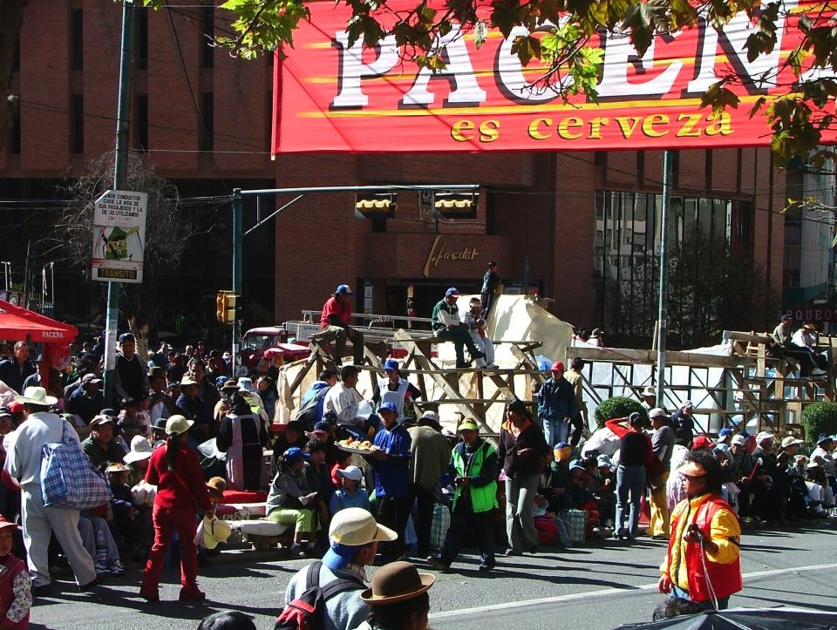
Notes:
14
Did the picture look like you imagined?
What was recalled accurately?
What was distorted?
Why do you think some of the details were distorted?
Was anything described that wasn’t in the picture? Where do you think these details came from?
Did the people who described the picture have enough information to really know about the picture?
Can you think of any situations in life where people don’t have enough information to really know something?
Where their expectations and attitudes inform what they think they see?
Do we sometimes make quick judgements about people when we don’t know about them?
Any further comments?

Slide 15

The Danger of a Single Story – Chimimanda Adiche
Image Credit: Chris Boland

Slide 16
“The single story creates stereotypes, and the problem with stereotypes is not that they are untrue, but that they are incomplete. They make one story become the only story.”
Chimamanda Adichie – Nigerian Novelist

Slide 17
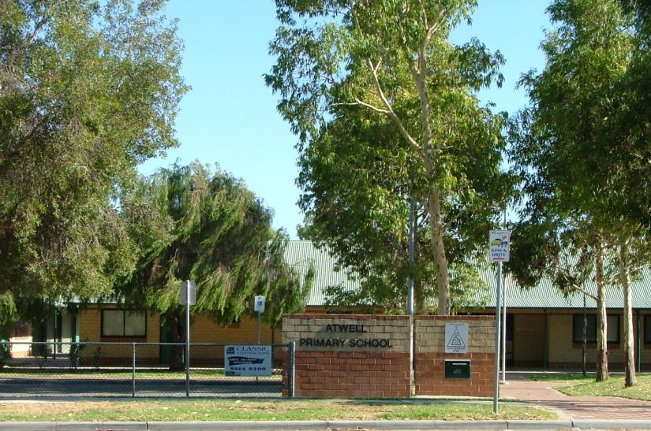
Image source and selection

Slide 18
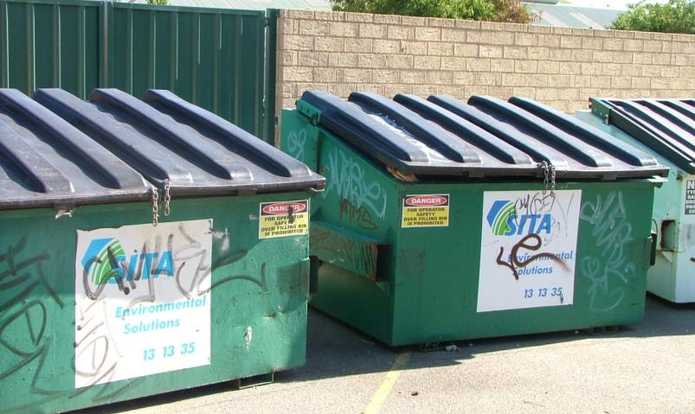
Image source and selection

Slide 19

Source: Intercultural Communication, Asia Education Teacher’s Journal Vol 29 Number 4 Nov 2001 p33.
The Iceberg of Culture
rituals
Underlying values make sense of the observable
food
religion
What you need to know and can actually see.
CUSTOMS
language
clothing
behaviour
environment
attitudes
tradition
VALUES
government
rules
statutes
roles
institutions
organisation
mores
gender roles
social structure
What you need to know but is less visible.
enculturation
Notes:
19

Slide 20
4 ways of thinking about culture
Contemporary / Traditional
Everyday / Ceremonial
Commonalities / Differences
Within / Between

Slide 21
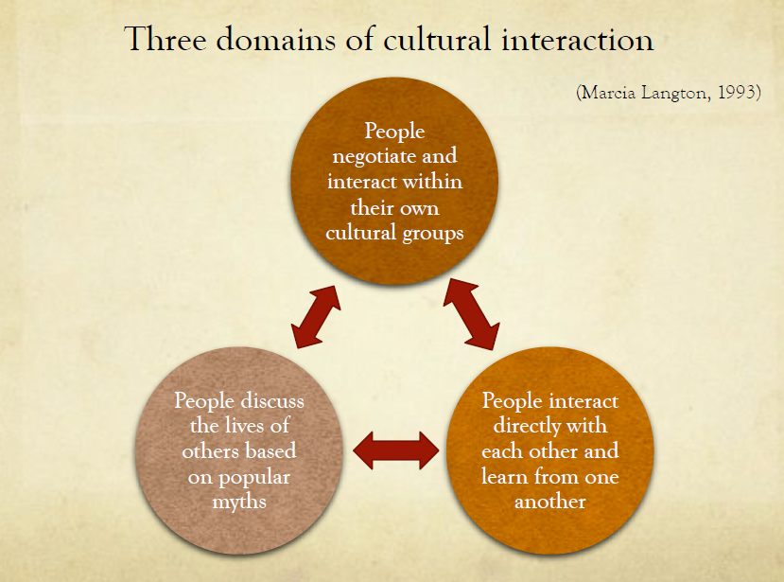

Slide 22
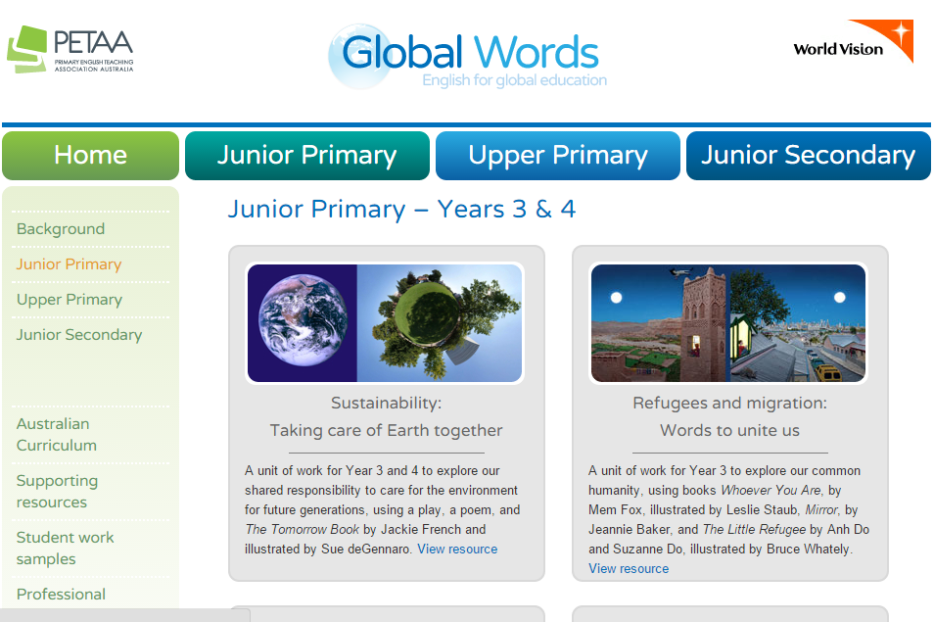
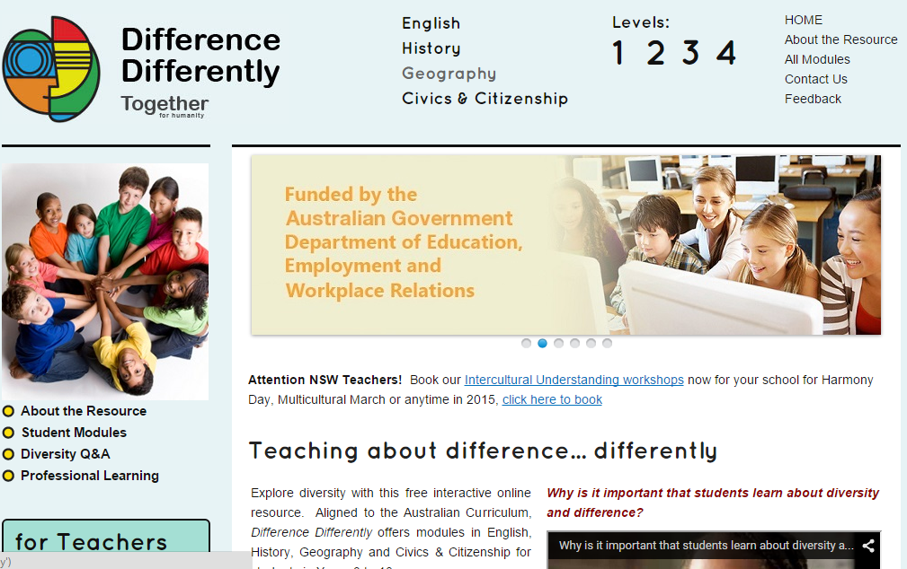
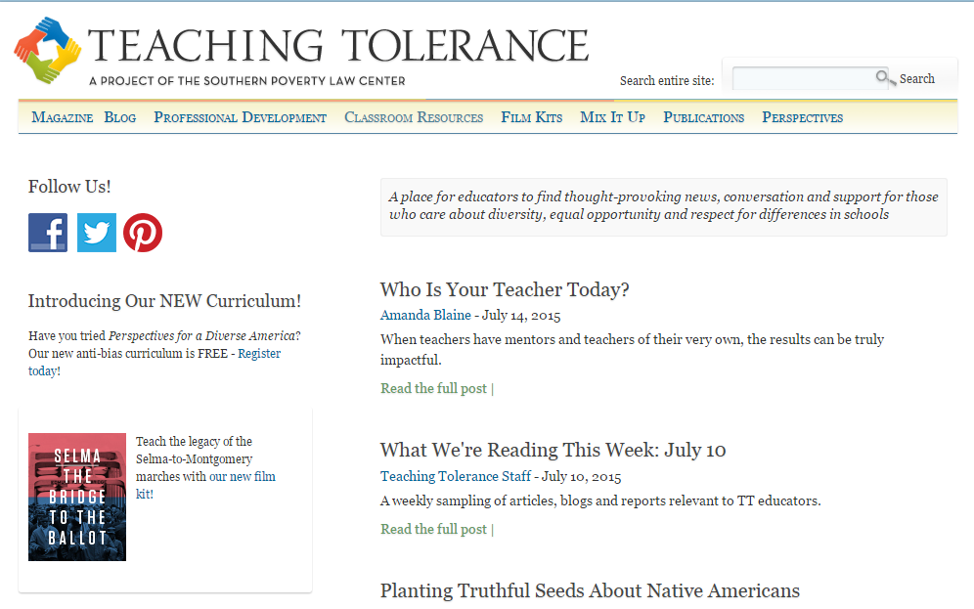
Useful resources

Slide 23
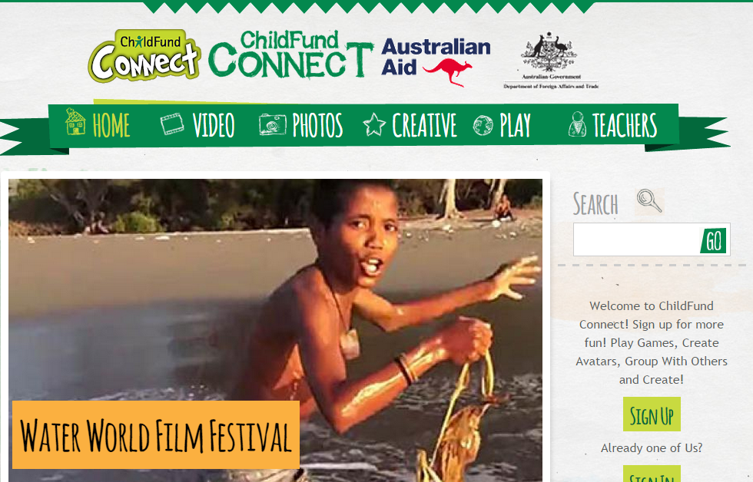
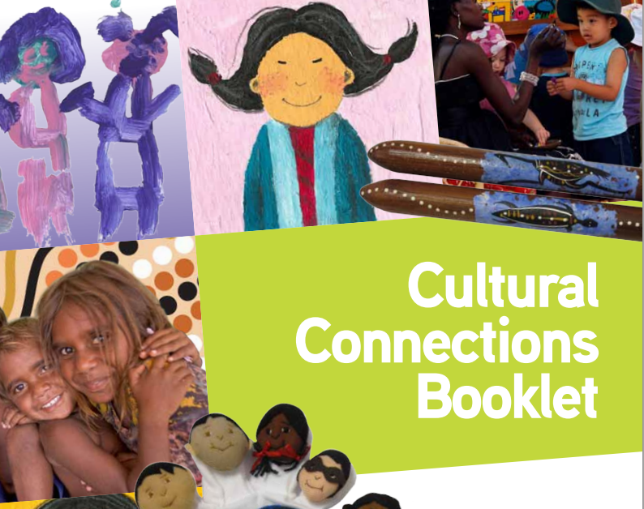
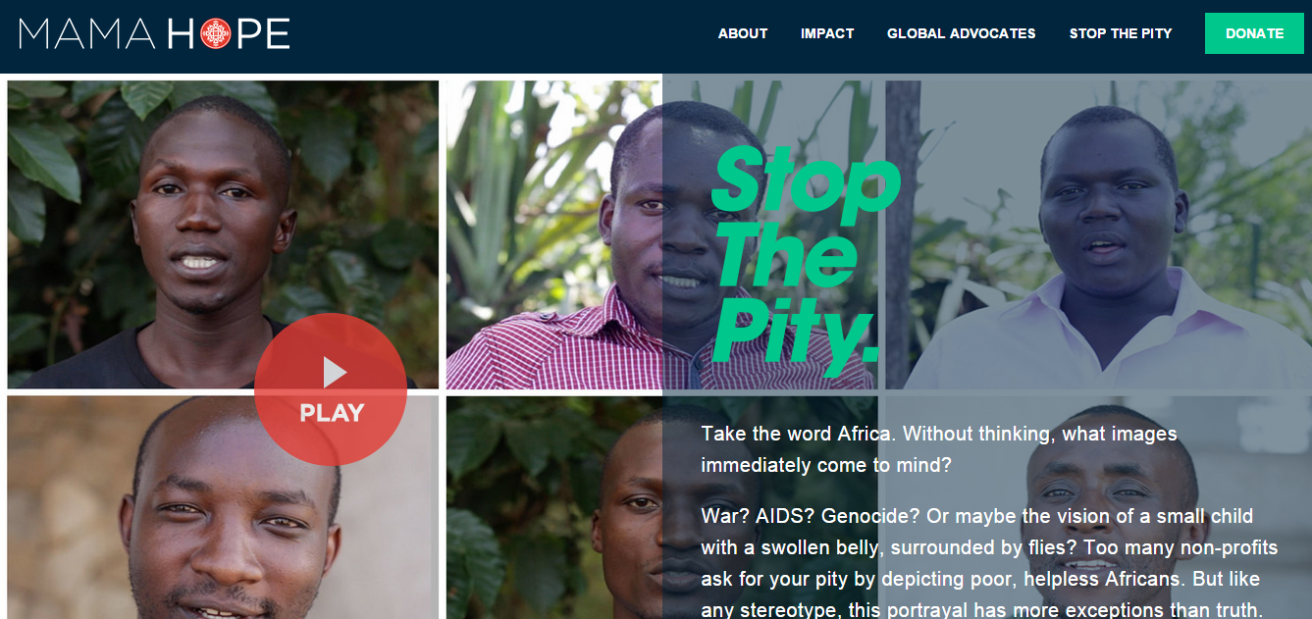
Useful resources

Slide 24
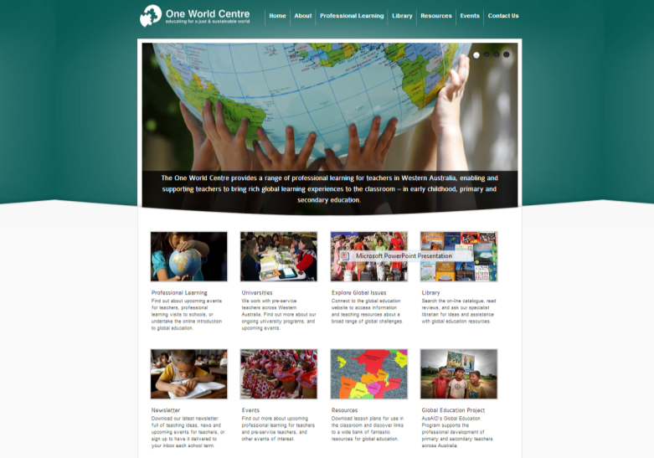
www.oneworldcentre.org.au

Slide 25
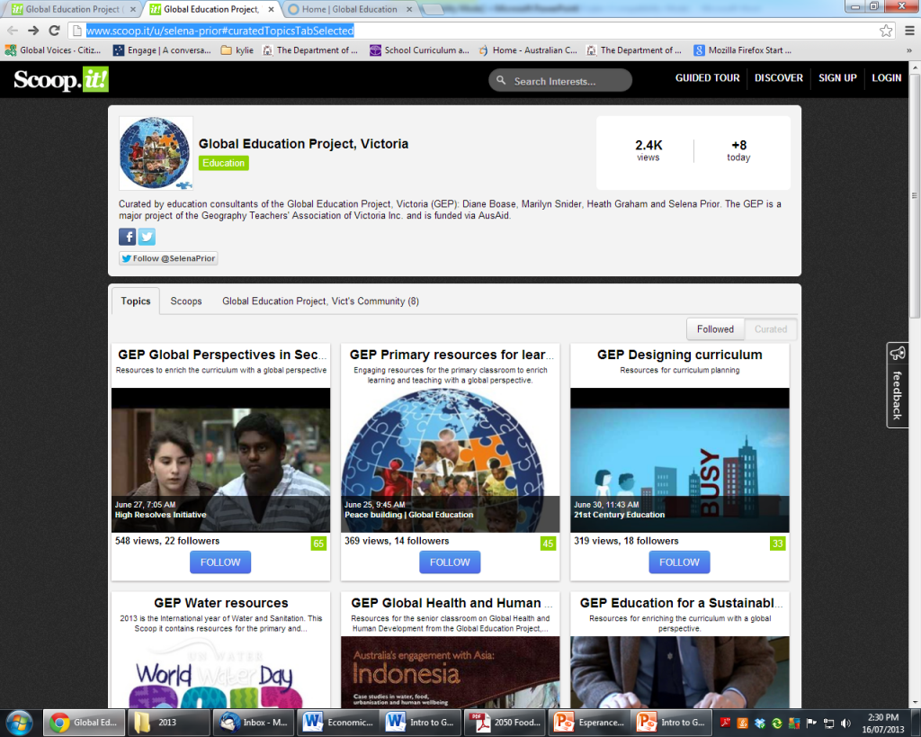
http://www.scoop.it/u/selena-prior#curatedTopicsTabSelected

Slide 26
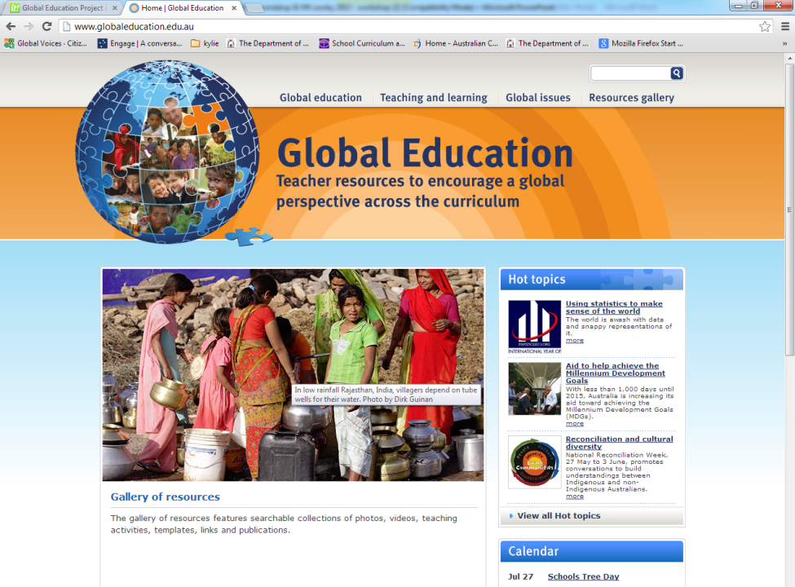
http://www.globaleducation.edu.au/

Slide 27
Contact us at:
5 King William St
Bayswater 6053
Ph: (08) 9371 9133
www.oneworldcentre.org.au
education@oneworldcentre.org.au
library@oneworldcentre.org.au

