Slide 1
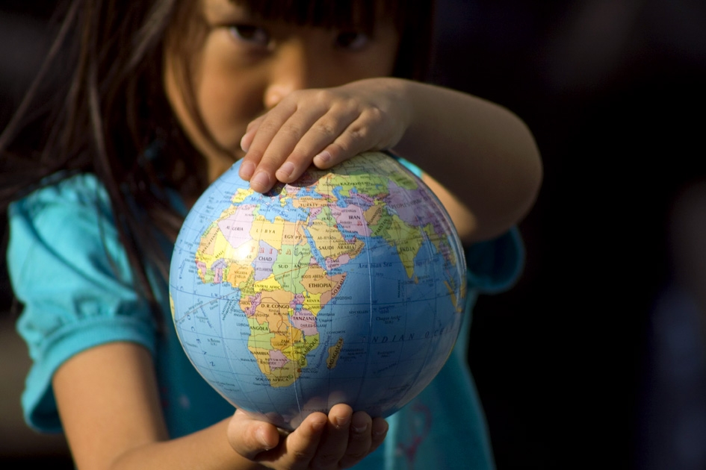

One World Centre
educating for a just and sustainable world

Slide 2
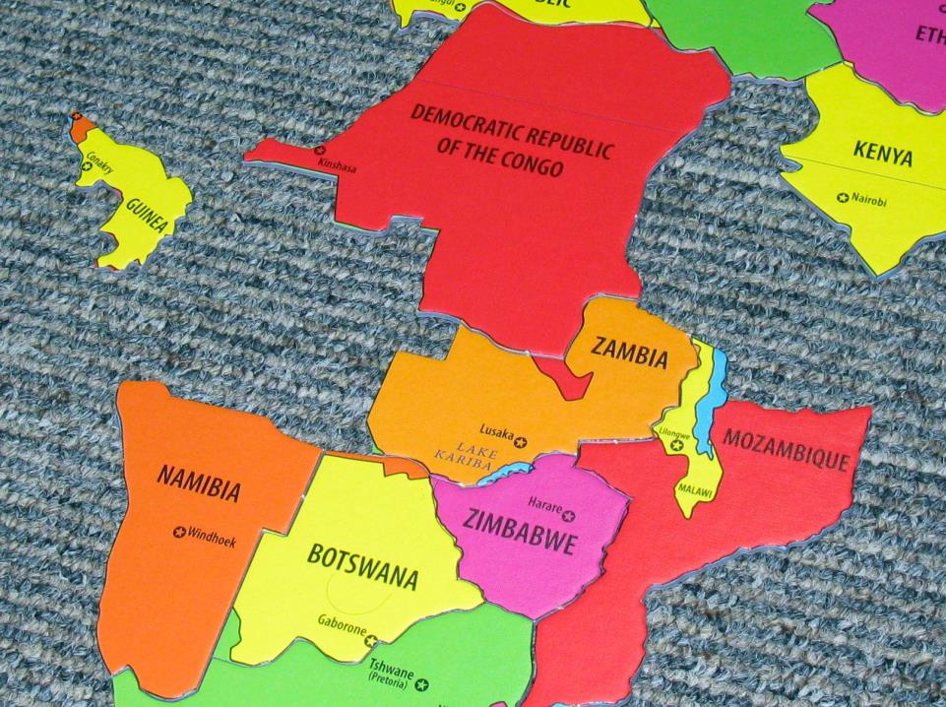
Global fact match
Notes:
Also available online as Miniature Earth vid or in

Slide 3
  Curriculum links:
Year 1 – 10 Geography skills: Posing and developing geographical questions.
Year 4, 5, 6 Geography: The location of the major countries from different regions (Africa, Asia, South America …)
Year 9 Geography: Geographies of interconnections focuses on investigating how people, through their choices and actions, are connected to places throughout the world in a wide variety of ways, and how these connections help to make and change places and environments.

Slide 4


The Danger of a Single Story – Chimimanda Adiche
Image Credit: Chris Boland

Slide 5
What’s Global Education?
“Enabling young people to participate in a better shared future for all is at the heart of global education.
Global education promotes open-mindedness leading to new thinking about the world and a predisposition to take action for change. Students learn to take responsibility for their actions, respect and value diversity, and see themselves as global citizens who can contribute to a more peaceful, just and sustainable world”
Global Perspectives: A framework for global education in Australian Schools Commonwealth of Australia, 2008

Slide 6
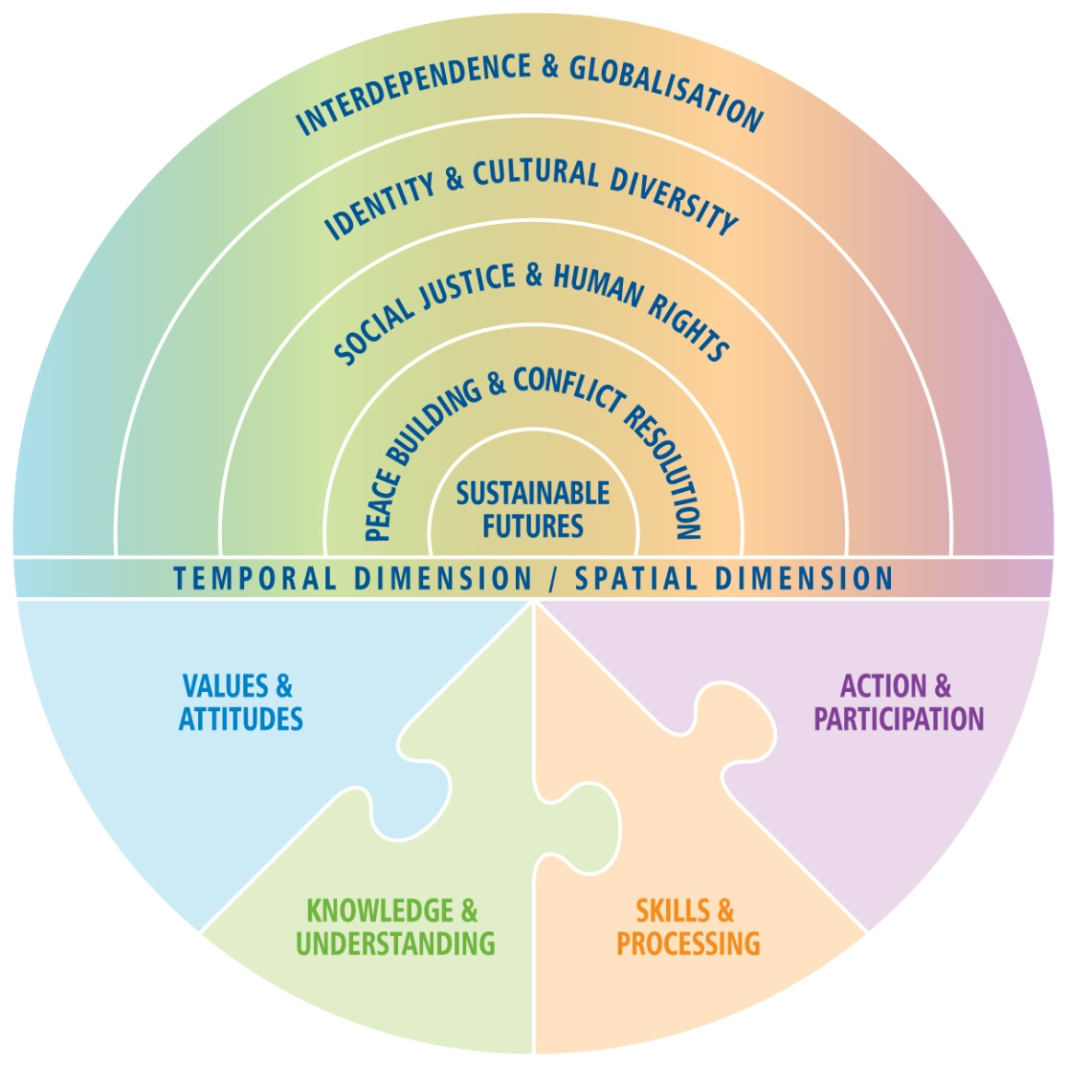
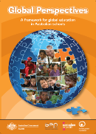
Notes:
6

Slide 7
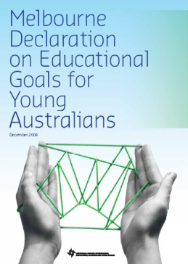
Goal 2: All young Australians become successful learners, confident and creative individuals, and active and informed citizens
2008 Melbourne Declaration on Educational Goals for Young Australians.
Notes:
7

Slide 8
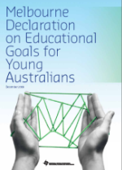
  Active and informed citizens:
        are committed to national values of democracy, equity and justice, and participate in Australia’s civic life
are able to relate to and communicate across cultures
work for the common good, in particular sustaining and improving natural and social environments
are responsible global and local citizens.
act with moral and ethical integrity

Slide 9
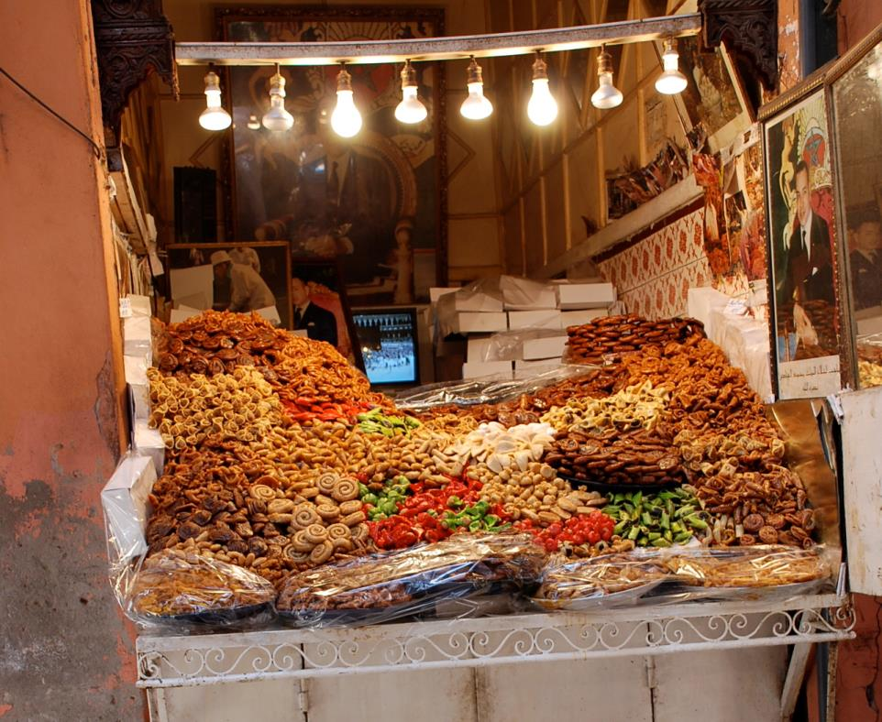
morning tea
Morning tea

Slide 10
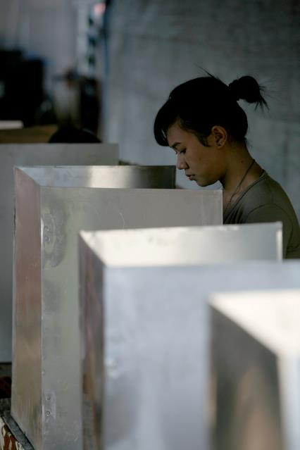
The Election

Slide 11
  Curriculum links:
Year 3 Civics and Citizenship: How and why decisions are made democratically in communities.
Year 5 Geography: The influence of people, including Aboriginal and Torres Strait Islander Peoples, on the environmental characteristics of Australian places
Year 10 History: The environment movement The intensification of environmental effects in the twentieth century as a result of population increase, urbanisation, increasing industrial production and trade

Slide 12
Rockstrom, Sachs, Ohman & Schmit-Traub (2013) Sustainable Development & Planetary Boundaries.
http://www.post2015hlp.org/wp-content/uploads/2013/06/Rockstroem-Sachs-Oehman-Schmidt-Traub_Sustainable-Development-and-Planetary-Boundaries.pdf

Slide 13
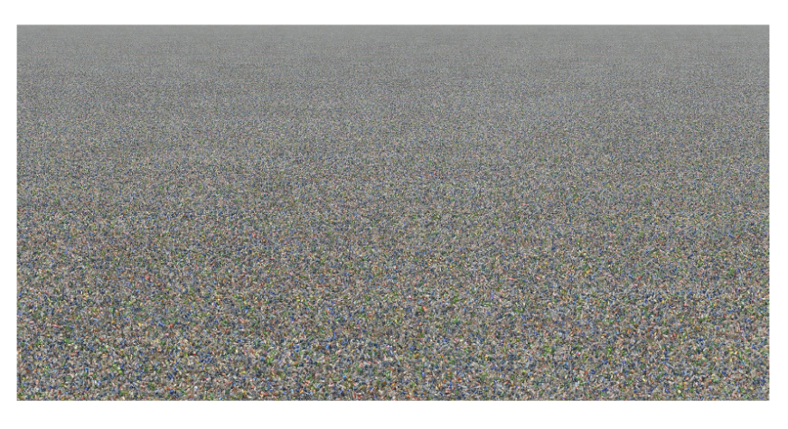
http://www.chrisjordan.com/gallery/rtn

Slide 14
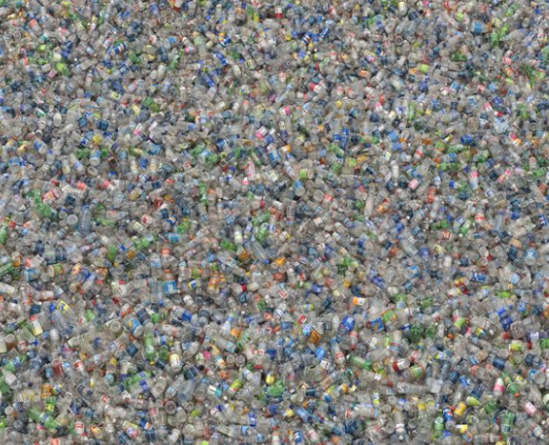
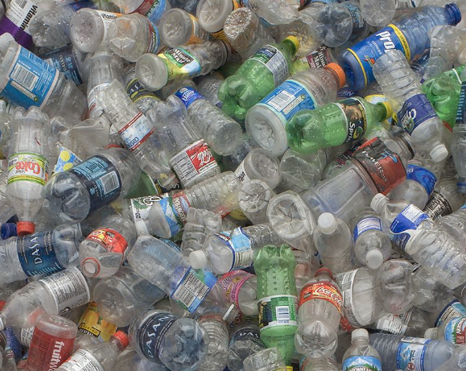

Slide 15
Interlocking pillars of Sustainability
(UNESCO)
NATURAL
The conservation of living things, resources and support systems
ECONOMIC
Employment and income that is ongoing and fair
SOCIAL
Peace, equality and human rights, especially for the most vulnerable
POLITICAL
Access to decision-making and influence over your own life and place

Slide 16
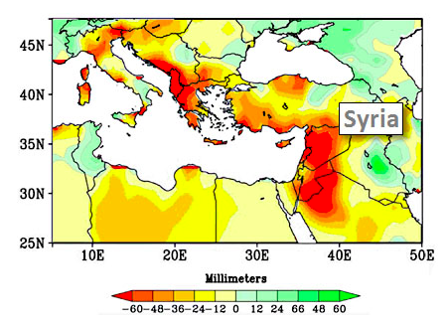
Mediterranean regions: changes in rainfall, 1971 – 2010
Source: National Oceanic and Atmospheric Administration

Slide 17
Australian Sustainable Schools Initiative (AuSSI-WA)

Slide 18
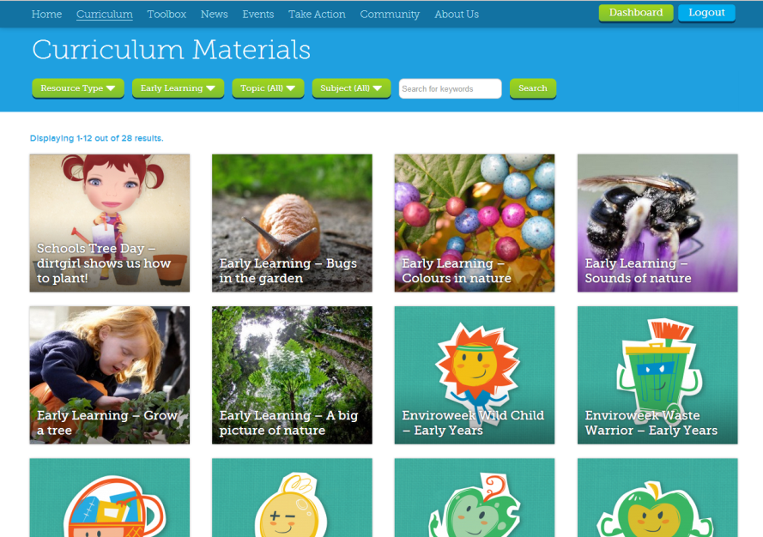
Cool Australia – sustainability lesson plans and resources for early childhood – Yr 10

Slide 19
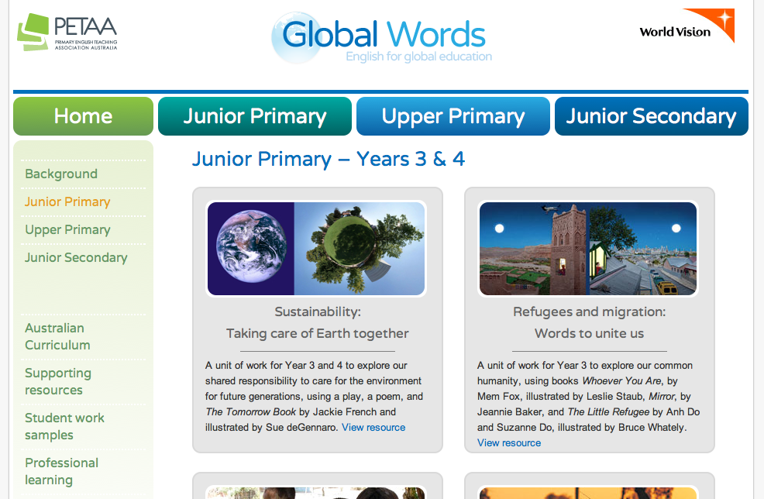
www.globalwords.edu.au

Slide 20
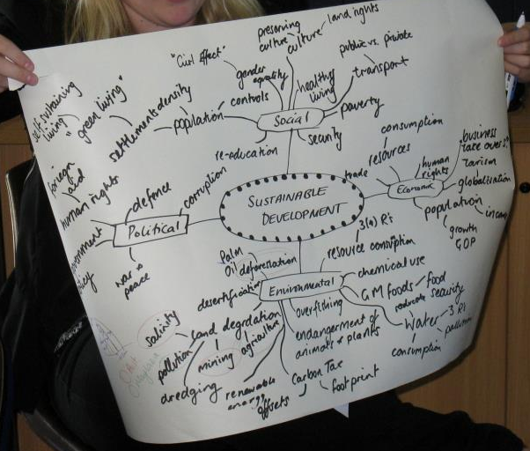
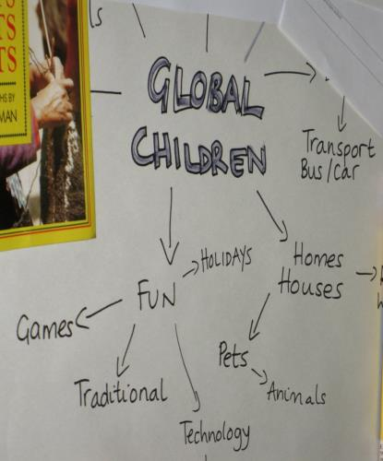
Brainstorm

Slide 21
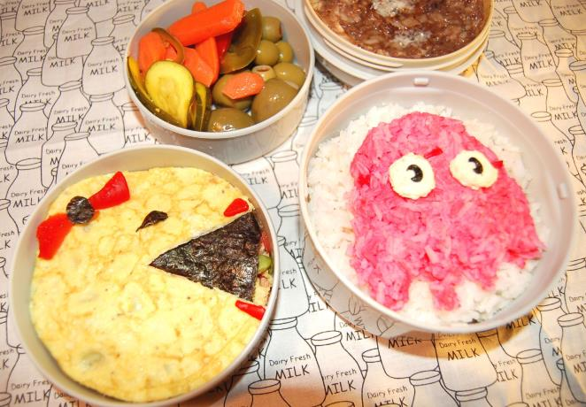
lunch
lunch
Image by Nadja Robot under Creative Commons License (CC BY-NC 2.0)

Slide 22
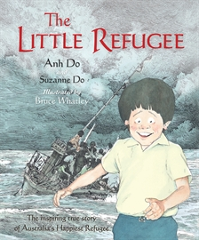
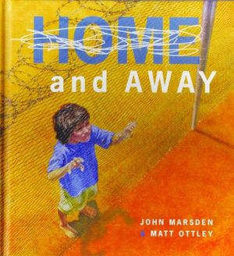

lunch
Story time

Slide 23
Choose some specific content from the brainstorm
Include ideas for evaluation
Connection to the Global Education framework: consider GE themes and how activities develop values and attitudes, knowledge and understanding, skills, and capacity for taking action
Develop a series of learning activities: include aims and specific lesson ideas
Identify Australian Curriculum Links: Learning areas, year level, CCPs, General capabilities
List relevant resources: books, AV materials, kits, online sources, experiential resources (guests, excursions, etc)

Slide 24
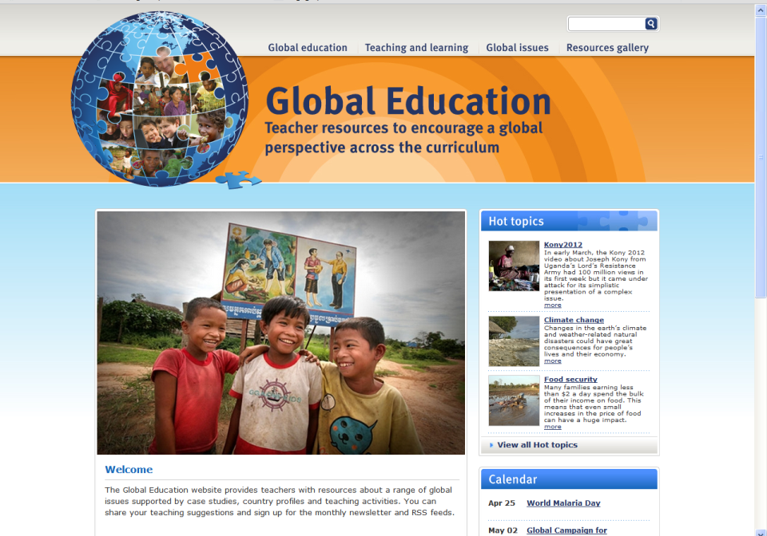
http://www.globaleducation.edu.au/

Slide 25


www.facebook.com/oneworldcentre
www.twitter.com/oneworldcentre

Slide 26
Contact us at:
5 King William St
Bayswater 6053
Ph: (08) 9371 9133
www.oneworldcentre.org.au
primaryed@oneworldcentre.org.au
education@oneworldcentre.org.au

Slide 27
The Great Divide
A game of opinion and fact
Help students clarify their own values
To encourage all to participate
To help students realise there are many sides to an issue
To encourage turn taking and listening skills

Slide 28
I am optimistic about the global future
Learning about global challenges is depressing
Schools must provide opportunities to act as well as learn
The Australian Curriculum has lots of opportunities for global learning
My class will be made up of students from diverse cultural backgrounds
Cultural diversity is just as important as biodiversity
Some global issues are too complex for young students to learn about
I feel confident about including a global perspective in my classroom

Slide 29
De-briefing ‘The Great Divide’
Which statements caused the most controversy?
Which one was most difficult for you?
Why do you think we used the power ball / talking stick?
What controversial statements can you come up with?
How did you feel having to make decisions about where to stand?
Was there pressure
  From other students?
  Because of uncertainty about the issue?
  Because of uncertainty about your own beliefs?

Slide 30
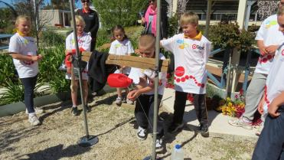
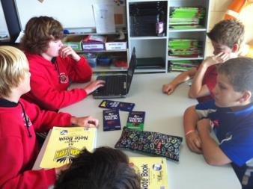
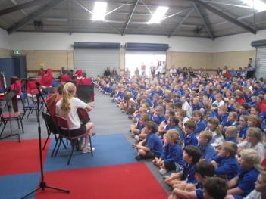
Actions for Change
LEARN
TALK
BUY
DONATE
SHOUT
VOLUNTEER
LIVE
http://www.globaleducation.edu.au/teaching-and-learning/school-case-studies.html

Slide 31
Contact us at:
5 King William St
Bayswater 6053
Ph: (08) 9371 9133
www.oneworldcentre.org.au
primaryed@oneworldcentre.org.au
education@oneworldcentre.org.au

