Slide 1


One World Centre
educating for a just and sustainable world

Slide 2
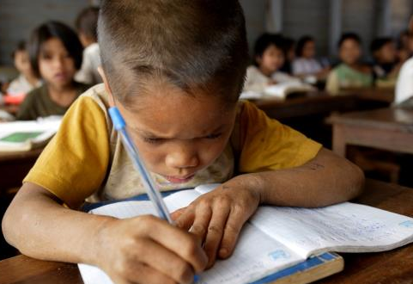
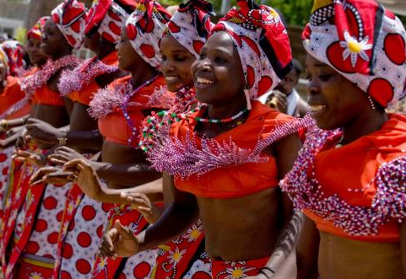

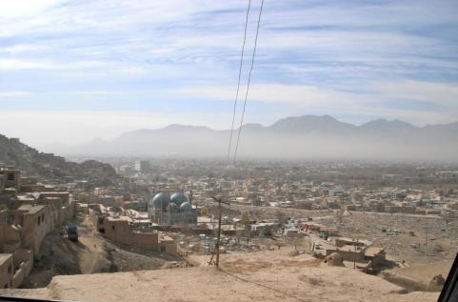

Global images
Photo credits: AusAID and One World Centre

Slide 3
  Curriculum links:
Year 1 English: Engage in conversations and discussions, using active listening behaviours, showing interest, and contributing ideas, information and questions (ACELY1656)
Year 5 Science: Scientific understandings, discoveries and inventions are used to solve problems that directly affect peoples’ lives (ACSHE083)
Year 10 Geography: The issues affecting the development of places and their impact on human well-being, drawing on a study from a developing country or region in Africa, South America or the Pacific islands. (ACHGK078)

Slide 4
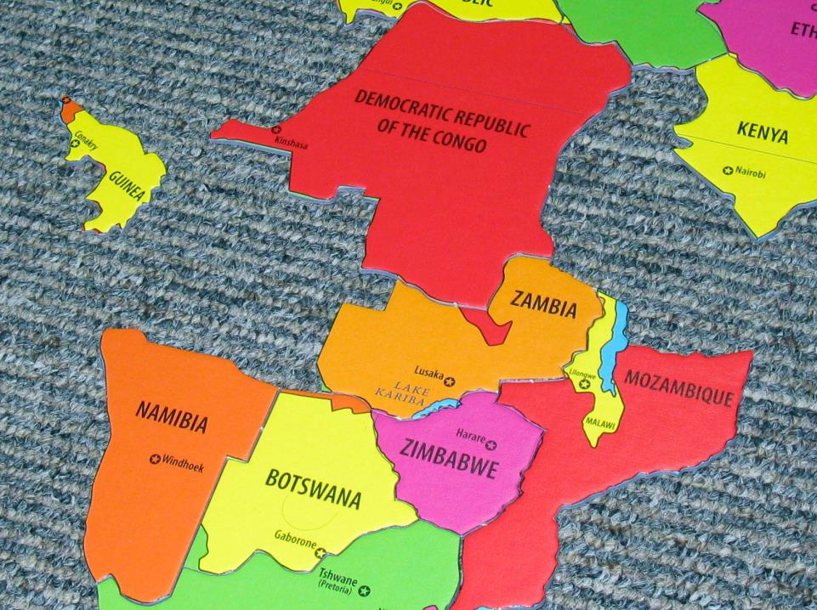
Global fact match
Notes:
Also available online as Miniature Earth vid or in

Slide 5
  Curriculum links:
Year 1 – 10 Geography skills: Posing and developing geographical questions.
Year 4, 5, 6 Geography: The location of the major countries from different regions (Africa, Asia, South America …)
Year 9 Geography: Geographies of interconnections focuses on investigating how people, through their choices and actions, are connected to places throughout the world in a wide variety of ways, and how these connections help to make and change places and environments.

Slide 6

The Danger of a Single Story – Chimimanda Adiche
Image Credit: Chris Boland

Slide 7
What’s Global Education?
“Enabling young people to participate in a better shared future for all is at the heart of global education.
Global education promotes open-mindedness leading to new thinking about the world and a predisposition to take action for change. Students learn to take responsibility for their actions, respect and value diversity, and see themselves as global citizens who can contribute to a more peaceful, just and sustainable world”
Global Perspectives: A framework for global education in Australian Schools Commonwealth of Australia, 2008

Slide 8
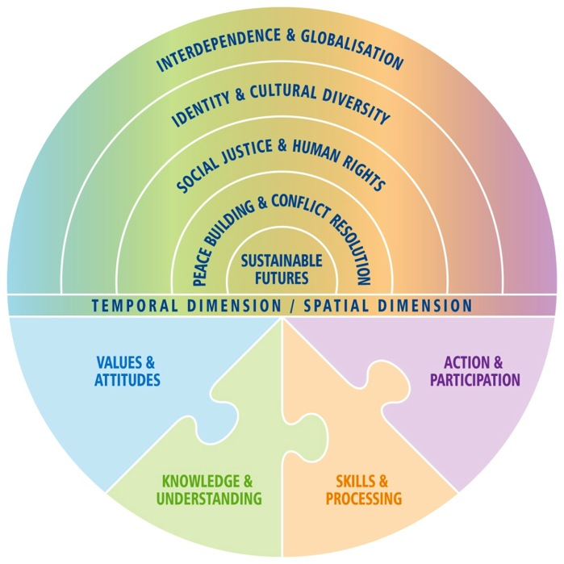
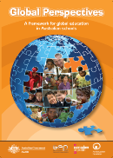
Notes:
8

Slide 9
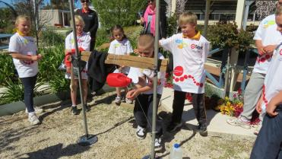
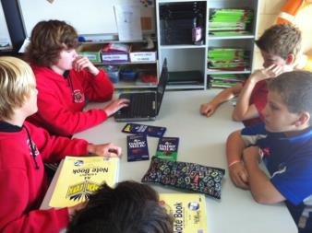
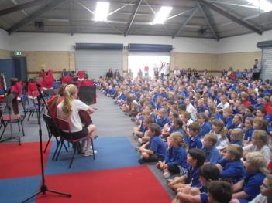
Actions for Change
LEARN
TALK
BUY
DONATE
SHOUT
VOLUNTEER
LIVE
http://www.globaleducation.edu.au/teaching-and-learning/school-case-studies.html

Slide 10
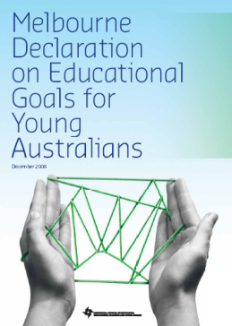
Goal 2: All young Australians become successful learners, confident and creative individuals, and active and informed citizens
2008 Melbourne Declaration on Educational Goals for Young Australians.
Notes:
10

Slide 11
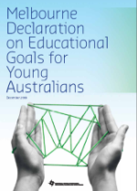
  Active and informed citizens:
        are committed to national values of democracy, equity and justice, and participate in Australia’s civic life
are able to relate to and communicate across cultures
work for the common good, in particular sustaining and improving natural and social environments
are responsible global and local citizens.
act with moral and ethical integrity

Slide 12

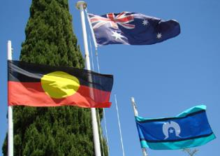
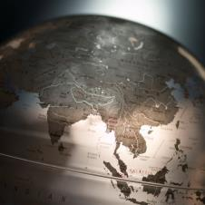

AC: 3 Cross curriculum priorities
Sustainability:
environmental
social
political
Aboriginal and Torres Strait Islander Histories and Cultures
Asia and Australia’s Engagement with Asia
Notes:
Interconnectedness – here in Australia and beyond
Diversity – being culturally competent, valuing the lives and stories of others
Taking informed action for the future

Slide 13
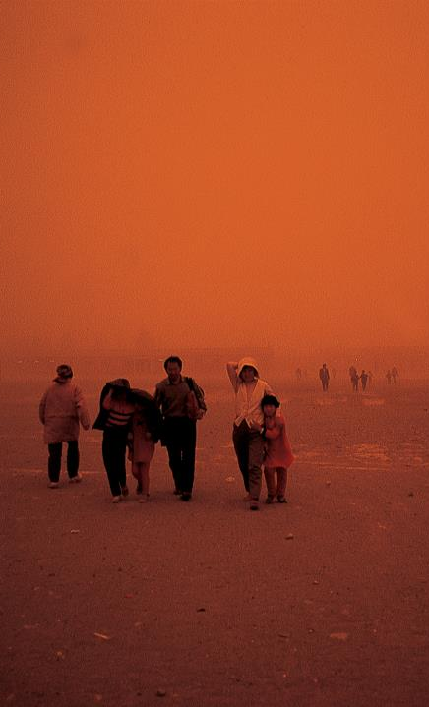
Interconnectedness – here in Australia and beyond
Diversity – being culturally competent, valuing the lives and stories of others
Taking informed action for the future

Slide 14
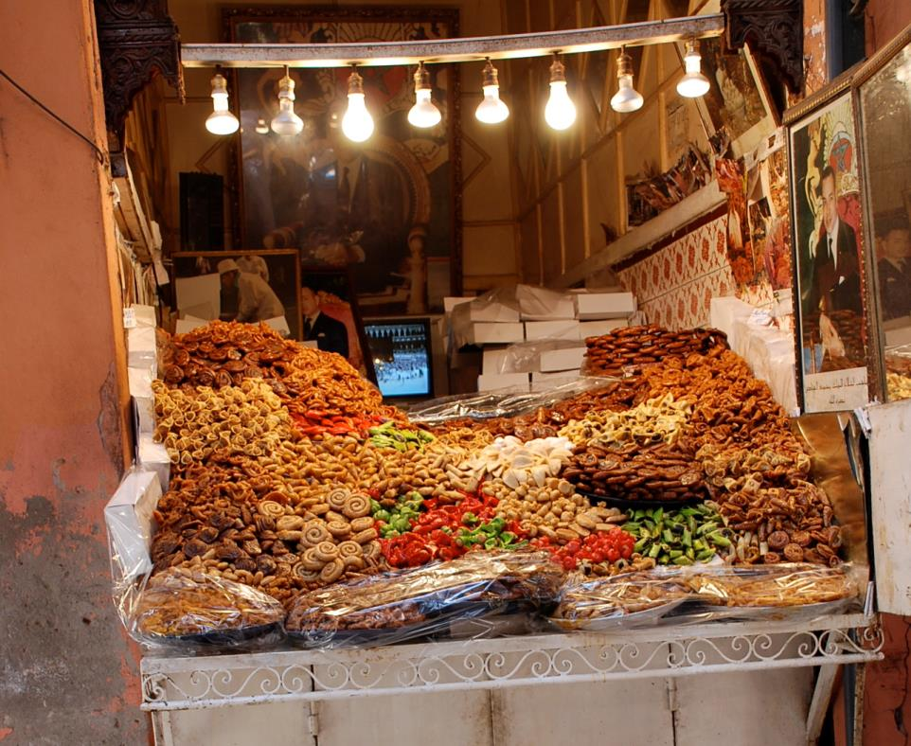
morning tea
Morning tea

Slide 15
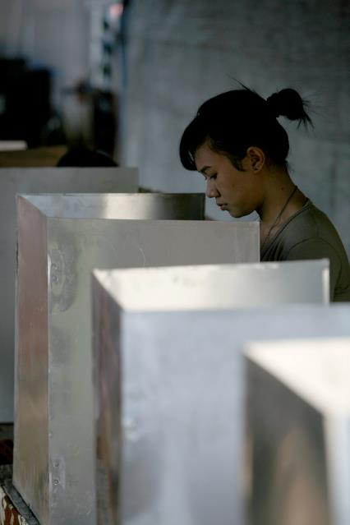
The Election

Slide 16
  Curriculum links:
Year 3 Civics and Citizenship: How and why decisions are made democratically in communities.
Year 5 Geography: The influence of people, including Aboriginal and Torres Strait Islander Peoples, on the environmental characteristics of Australian places
Year 10 History: The environment movement The intensification of environmental effects in the twentieth century as a result of population increase, urbanisation, increasing industrial production and trade

Slide 17
Rockstrom, Sachs, Ohman & Schmit-Traub (2013) Sustainable Development & Planetary Boundaries.
http://www.post2015hlp.org/wp-content/uploads/2013/06/Rockstroem-Sachs-Oehman-Schmidt-Traub_Sustainable-Development-and-Planetary-Boundaries.pdf

Slide 18

http://www.chrisjordan.com/gallery/rtn

Slide 19
Interlocking pillars of Sustainability
(UNESCO)
NATURAL
The conservation of living things, resources and support systems
ECONOMIC
Employment and income that is ongoing and fair
SOCIAL
Peace, equality and human rights, especially for the most vulnerable
POLITICAL
Access to decision-making and influence over your own life and place

Slide 20
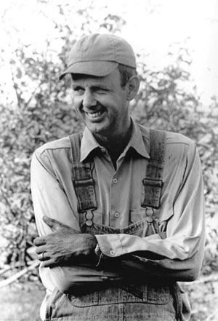
Image: The Bridge Progressive Arts Initiative

Slide 21
Australian Sustainable Schools Initiative (AuSSI-WA)

Slide 22
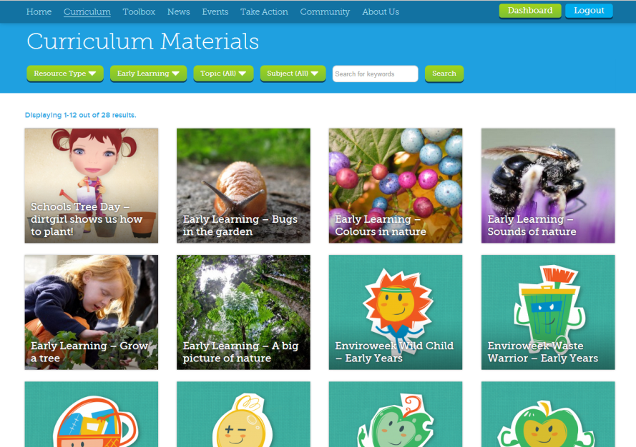
Cool Australia – sustainability lesson plans and resources for early childhood – Yr 10

Slide 23
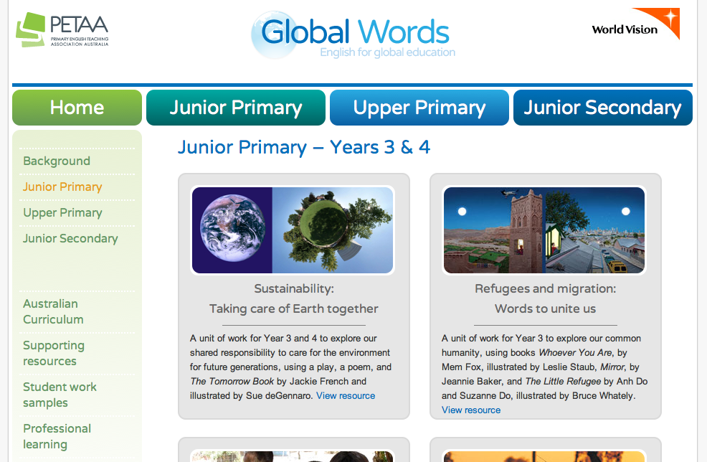
www.globalwords.edu.au

Slide 24

The Development Compass Rose
Natural
These are questions about the environment - the land, the sea, living things, and their relationship to each other. These questions are about the built as well as the natural environment
Who decides (political)
These are questions about power, who makes choices and decides what is to happen; who benefits or loses as a result of these decisions; and at what cost
Economic
These questions are about money, trading and ownership, buying and selling
Social
These are questions about people, their relationships, their traditions, culture and the way they live. They include questions about how, for example, gender, race, disability, class and age affect social relations
What are your questions?

Slide 25
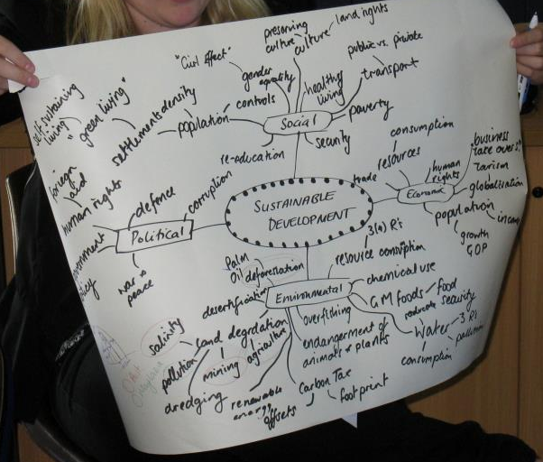
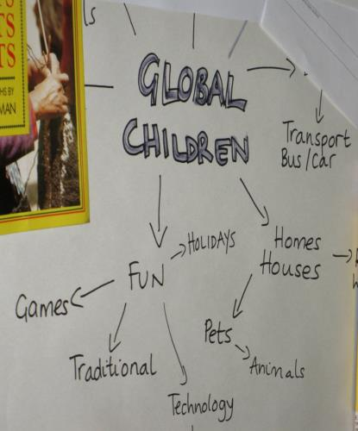
Brainstorm

Slide 26
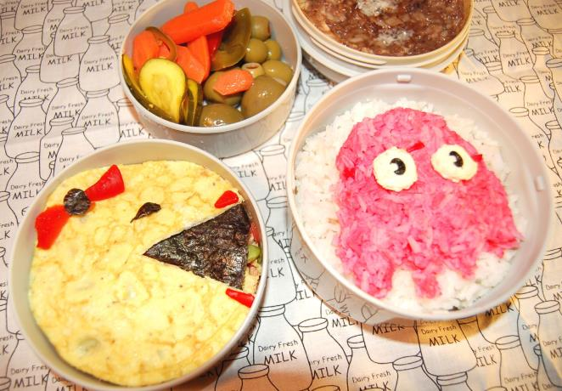
lunch
lunch
Image by Nadja Robot under Creative Commons License (CC BY-NC 2.0)

Slide 27
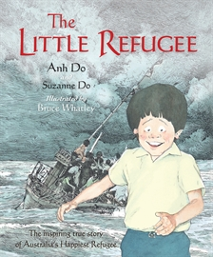
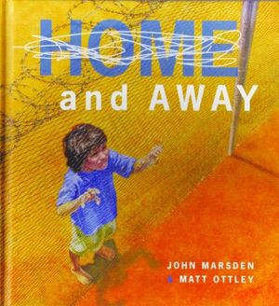
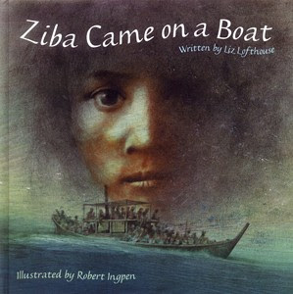
lunch
Story time

Slide 28
Choose some specific content from the brainstorm
Include ideas for evaluation
Connection to the Global Education framework: consider GE themes and how activities develop values and attitudes, knowledge and understanding, skills, and capacity for taking action
Develop a series of learning activities: include aims and specific lesson ideas
Identify Australian Curriculum Links: Learning areas, year level, CCPs, General capabilities
List relevant resources: books, AV materials, kits, online sources, experiential resources (guests, excursions, etc)

Slide 29
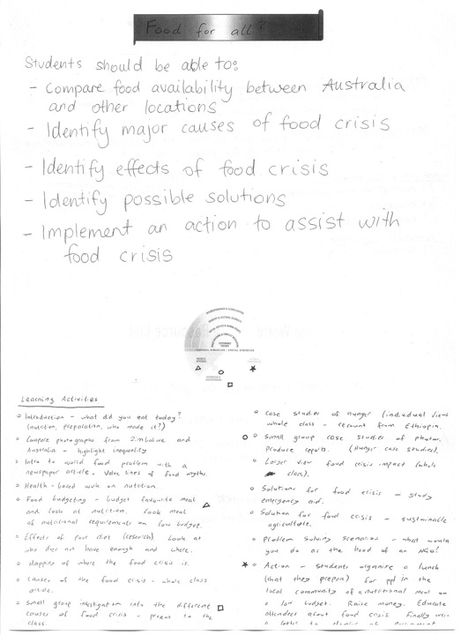

Slide 30
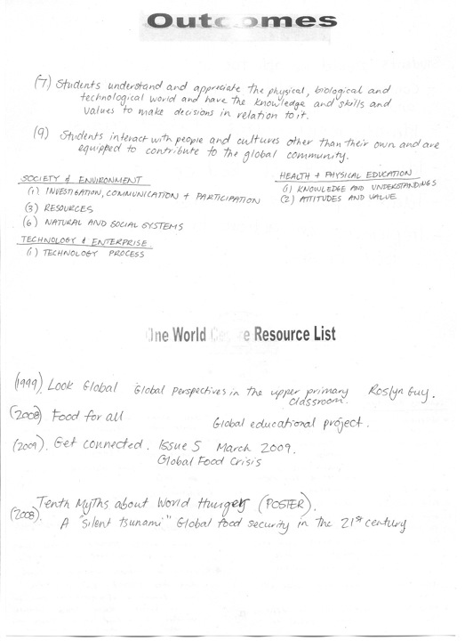

Slide 31
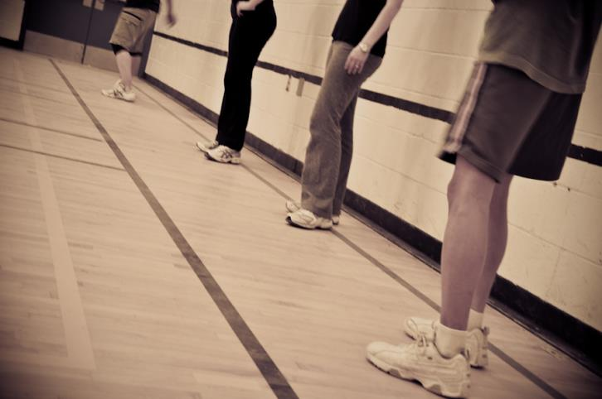
Dodge ball and the “level playing field”
Dodgeball 14 by Lightwork Studio 2. Creative Commons license (CC BY- NC - SA 2.0)

Slide 32
  Curriculum links:
Year 6 Geography: The various connections Australia has with other countries and how these connections change people and places
Year 9 Geography: Geographies of interconnections. The ways that places and people are interconnected with other places through trade in goods and services, at all scales
Year 8 Economics and Business: The ways markets operate in Australia and why they may be influenced by government
Year 7&8 Health and Physical Education: Movement and physical activity. Compose and perform movement sequences for specific purposes in a variety of contexts

Slide 33
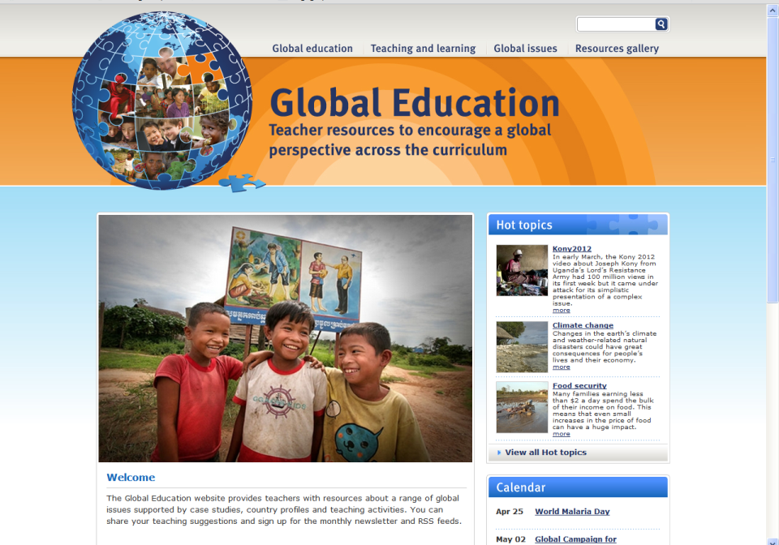
http://www.globaleducation.edu.au/

Slide 34


www.facebook.com/oneworldcentre
www.twitter.com/oneworldcentre

Slide 35
Contact us at:
5 King William St
Bayswater 6053
Ph: (08) 9371 9133
www.oneworldcentre.org.au
primaryed@oneworldcentre.org.au
education@oneworldcentre.org.au

